Slide 1
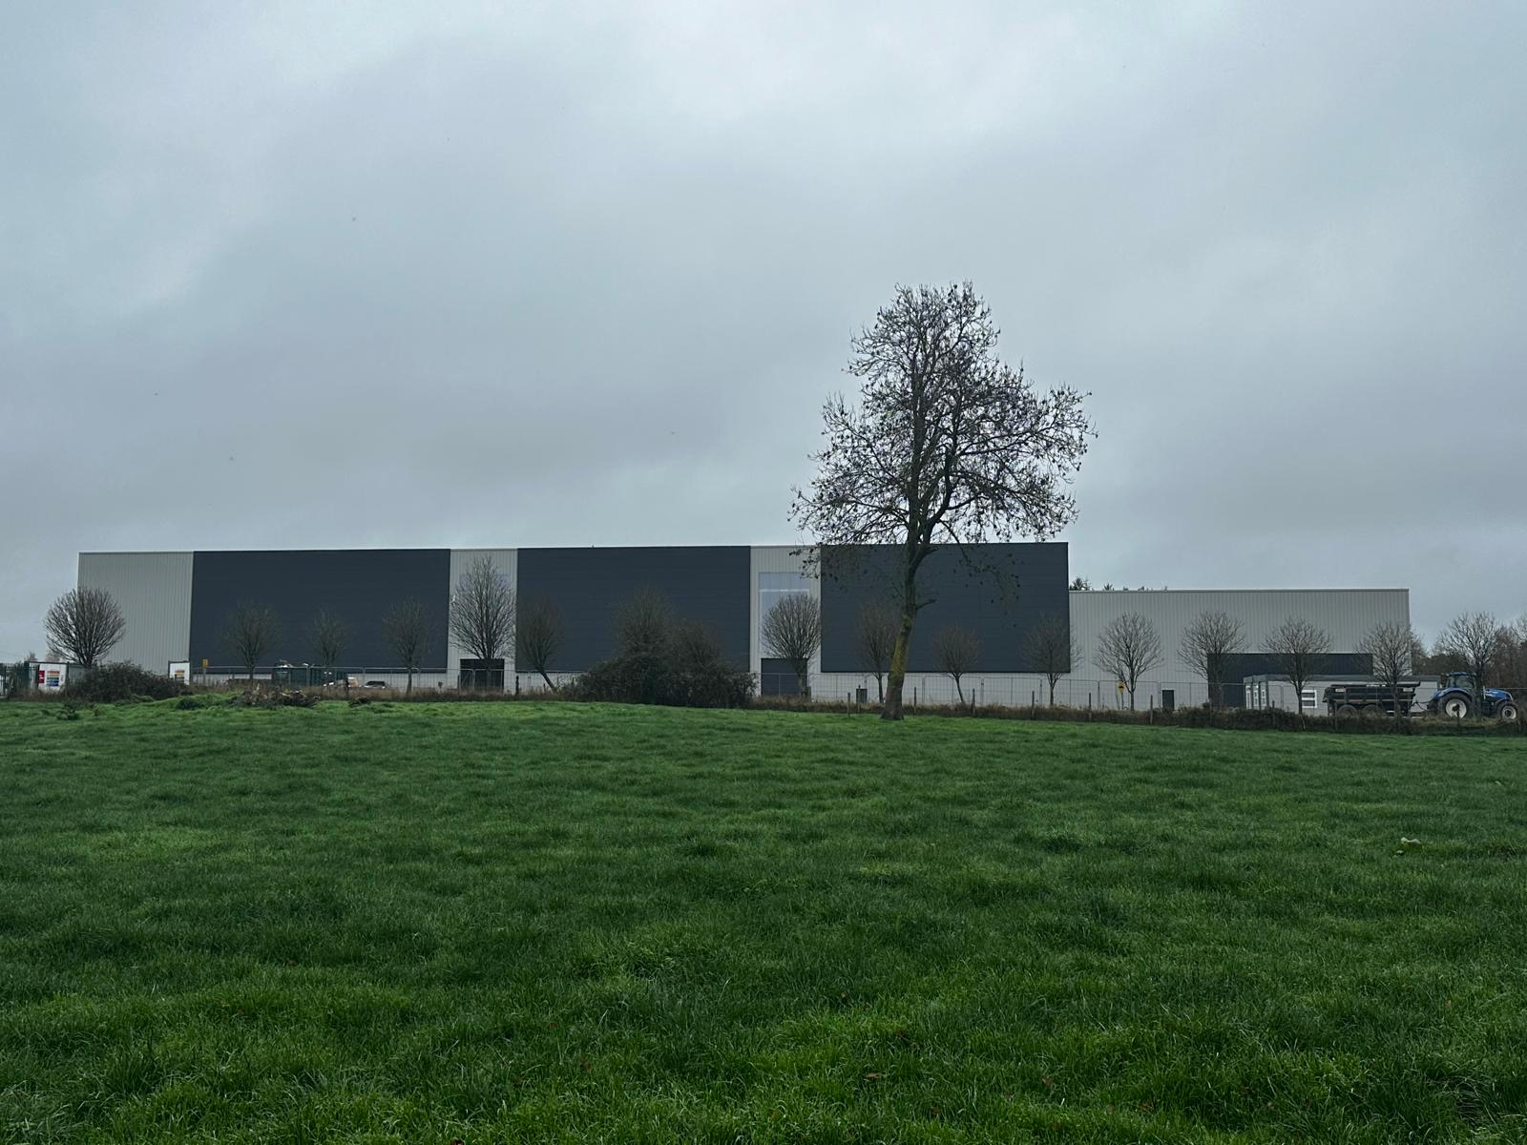

Strategic Infrastructure Development - Pre-application Consultation
10th October 2025

Slide 2
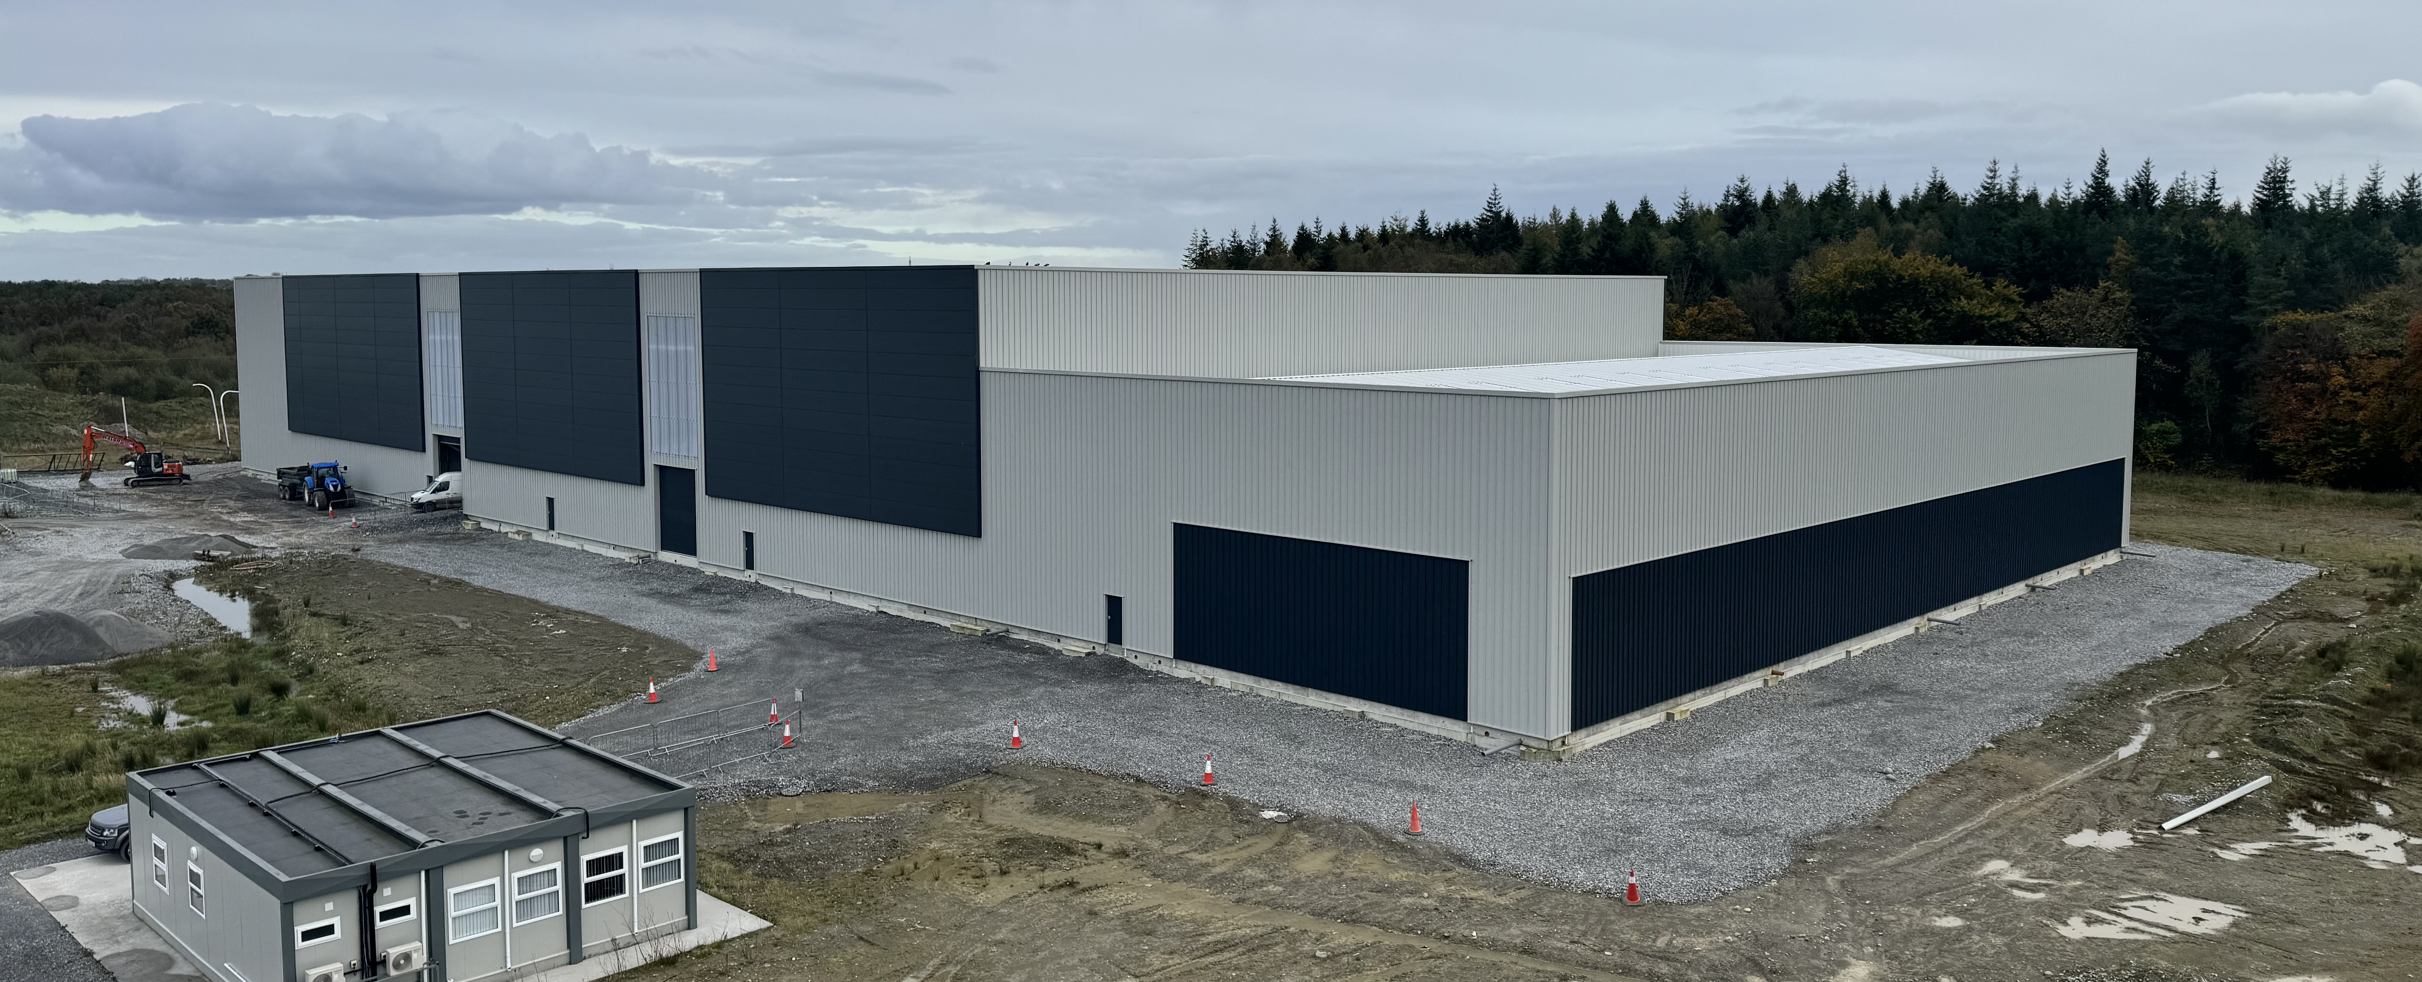
Overview | Attendees
1. Introduction & Background | 1. Raphael McEvoy – CEO
2. Proposed Development Description | 2. Sean Garry – Engineering Coordinator
3. Current Infrastructure Status | 3. Stephen Curtis – Finance
4. Planning Context | 4. Declan Brassil – Consultant
5. Waste Management Need | 5. Patrick Little – Axis Architecture
6. Questions

Slide 3
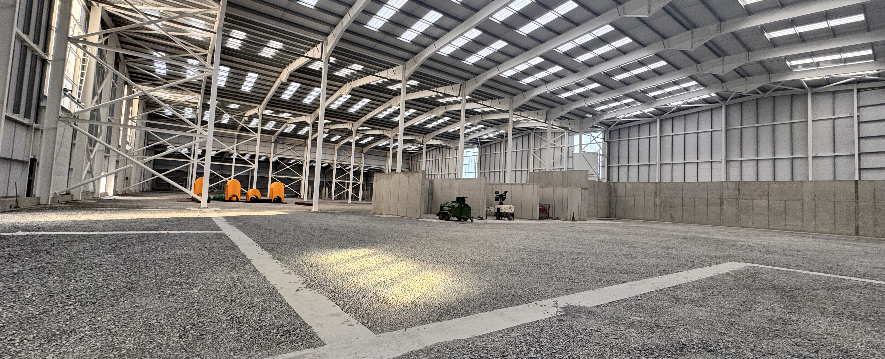
Introduction & Background
Glanpower Ltd was established to develop a waste to energy plant in Derryclure, Tullamore, Co. Offaly.
Glanpower was established to address both regional and national challenges arising from the closure of landfills and the ongoing export of waste from Ireland.
Currently, there are only two operational Waste-to-Energy (WTE) facilities in the Republic of Ireland:
  Dublin Waste-to-Energy Plant located in Poolbeg, Dublin and
  Indaver Waste-to-Energy Plant in Duleek, Co. Meath.
Glanpower will be the third WTE in the Republic of Ireland.

Slide 4
PROPOSED DEVELOPMENT DESCRIPTION
The development will consist of the alteration of the previously approved Derryclure Energy Centre (developed pursuant to a grant of permission from Offaly County Council (Ref. 10/307) and An Bord Pleanála (Ref. PL19.238420) to provide for the acceptance of up to 200,000 tonnes per annum (TPA) of non-hazardous waste material, including:
Increase in Permitted Tonnage
Upgrade to a Commercially Robust Advanced Conversion Technology (ACT)
New internal equipment layout and upgrade in process
Additional external plant to yard at the south of the building to include an air-cooled condensing unit, treatment tanks and residual process material collection area
The revision and relocation of the Flue stack to include emission monitoring platform and access arrangements
Relocation of transformer unit and backup generator unit.
Increase in size of the previously approved ESB substation
Alterations to external landscaping and boundary treatments to the site layout, external yard areas, roads, hardstanding’s and all associated siteworks and services

Slide 5
STRATEGIC INFRASTRUCTURE DEVELOPMENT
The provisions are set out in section 37CC and 182F of the 2000 Act.
Qualifying developments are listed in the Seventh Schedule contained in section 37A of the Planning & Development Act 2000 as amended.
Sub Section 3 – Environmental Infrastructure defines a qualifying project as
(a) waste disposal installation for the incineration, or (b) the chemical treatment (within the meaning of Annex IIA to Council Directive 75/442/EEC under heading D9) of non-hazardous waste with a capacity for an annual intake greater than 100,000 tonnes.
Strategic Infrastructure Development also includes development which would:
contribute significantly to meeting any of the objectives of the National Planning Framework, or
contribute significantly to meeting any regional spatial and economic strategy for an area, or
have a significant effect on the area of more than one planning authority.

Slide 6
OBJECTIVES OF THE NATIONAL PLANNING FRAMEWORK
National Policy Objective 70
Promote renewable energy use and generation at appropriate locations within the built and natural environment to meet national objectives towards achieving a climate neutral economy by 2050.
National Policy Objective 71
Support the development and upgrading of the national electricity grid infrastructure, including supporting the delivery of renewable electricity generating development.
National Policy Objective 76
Sustainably manage waste generation including construction and demolition waste, invest in different types of waste treatment and support circular economy principles, prioritising prevention, reuse, recycling and recovery, to support a healthy environment, economy and society.

Slide 7
OBJECTIVES OF THE RSES
RSES POLICY
10.25
Development Plans shall identify how waste will be reduced, in line with the principles of the circular economy, facilitating the use of materials at their highest value for as long as possible and how remaining quantum's of waste will be managed and shall promote the inclusion in developments of adequate and easily accessible storage space that supports the separate collection of dry recyclables and food and shall take account of the requirements of the Eastern and Midlands Region Waste Management Plan.
OCC POLICY
CAEP-25
It is Council policy to encourage and facilitate the production of energy from renewable sources, such as from bioenergy, waste material, solar, hydro, geothermal and wind energy, subject to proper planning and environmental considerations.

Slide 8
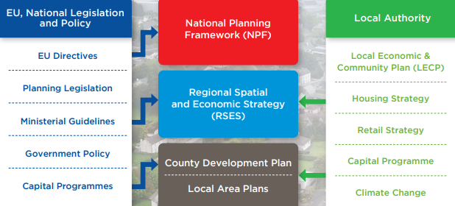
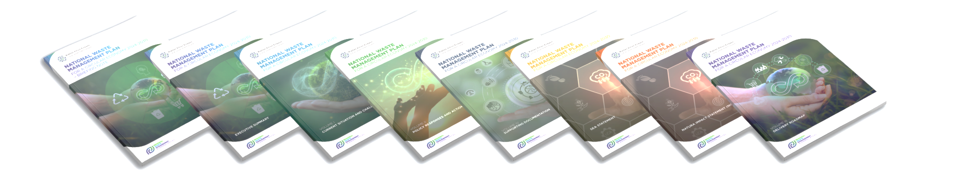
PLANNING HIERACHY
National Waste Management Plan 2024
NATIONAL WASTE MANAGEMENT PLAN 2024
3.13m tonnes MSW per annum
Management option | Thermal Treatment | Co - incineration | Disposal at landfill | Total capacity | Shortfall (exported)
No. facilities | 2 | 3 | 3
Tonnes processed 2025 | 942,500 | 335,714 | 458,000 | 1,736,214 | 1,393,786
Glanpower 200,000 Tonnes/Annum |  | 60% Increase | 44% reduction

Slide 9
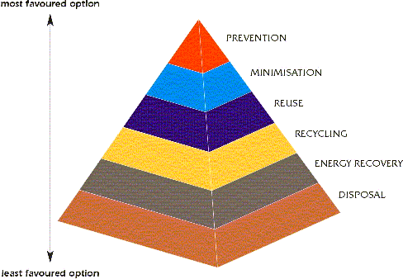
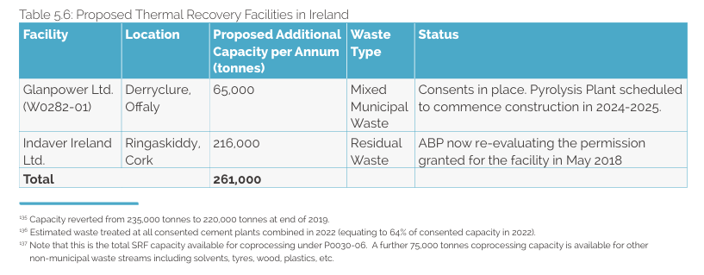
ROLE OF ENERGY FROM WASTE
POSITION OF GLANPOWER WITHIN THE NATIONAL WASTE MANAGEMENT PLAN 2024
APPENDIX 9 Guidance for Siting Waste Management Facilities. Section 3.7 Thermal Treatment Facilities

Slide 10
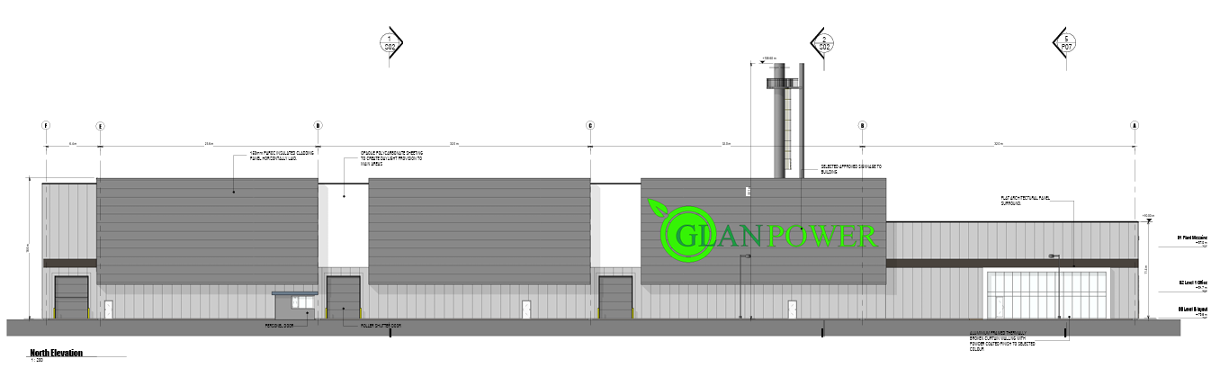
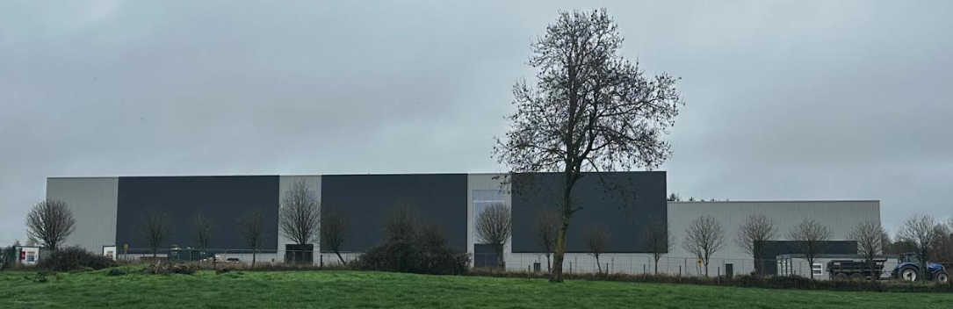
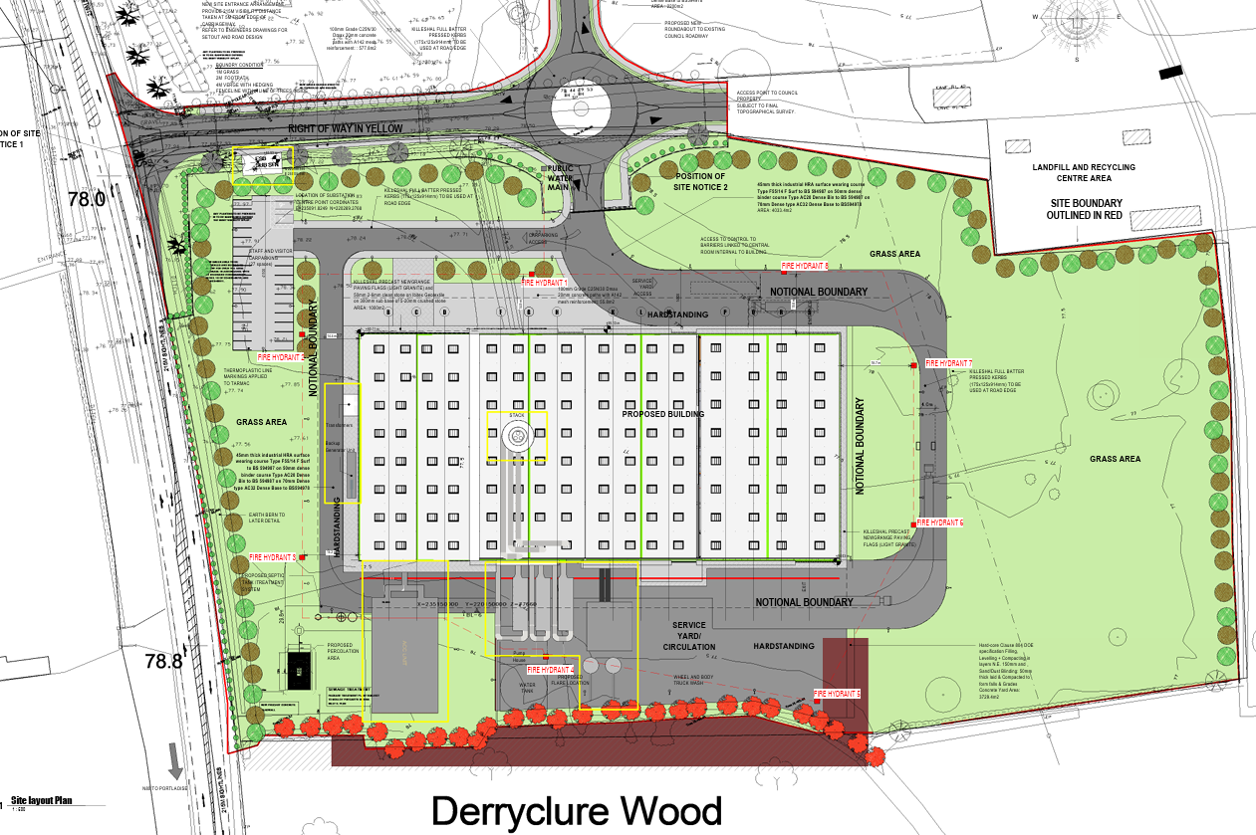
STATUS OF EXISTING DEVELOPMENT
Approved Planning Design
PROPOSED SID DEVELOPMENT
As Built Building
Upgraded substation
Revised Parking Layout
Transformers & Generators
Upgraded Stack Design
Air-cooled condensing unit
Treatment tanks and residual process material collection area

Slide 11
Questions & Discussion

